Slide 1
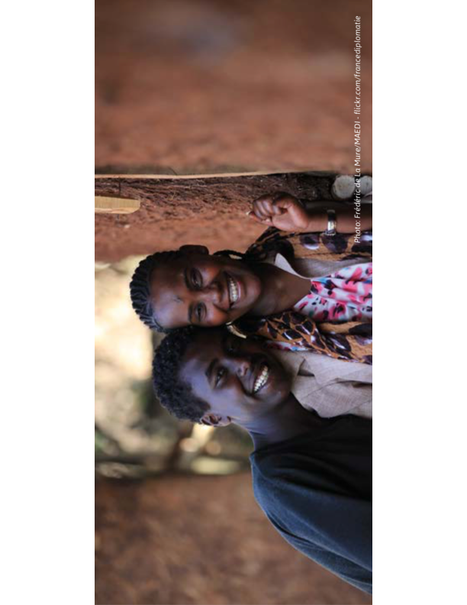
Lessons learned from national government-led efforts to reduce adolescent pregnancy in Chile, England & Ethiopia V Chandra-Mouli, M Plesons, A Hadley, M Maddaleno, L Oljira, S Tibebu, E Akwara, D Engel

Slide 2
Problem statement
Adolescent pregnancy is a global public health problem.
Most adolescents live in low & middle income countries.
Adolescent pregnancy & childbearing often have negative health, social & economic consequences. 95% occur in low & middle income countries.
Progress in reducing adolescent childbearing has been slow & uneven.
There is evidence of successful approaches to reduce adolescent pregnancy & childbearing from projects, but few examples of large scale and sustained programmes.

Slide 3
Lessons Learnt From National, Government- Led Efforts - Chile
Building government commitment
The government adopted the regional 2007-2013 Andean Plan for Prevention of Adolescent Pregnancy in response to the high adolescent fertility rate (55.8 births per 1000 women aged 15-19 years in 2005)
It targeted a 10% reduction in the adolescent fertility rate in the 2011–2020 National Health Strategy.
It strengthened the National Comprehensive Health Programme for Adolescents/Youth & the corresponding Strategic Action Plan
Planning scale up
The government developed a five-pronged approach to improve the health system’s responsiveness to adolescents for the ten-year strategy: training health workers, creating adolescent spaces in primary health centres, promoting a range of contraceptive methods, improve outreach & referrals, and supporting school retention & reentry for pregnant adolescents/adolescent mothers.
It issued new circulars on parental consent requirements, adolescents’ autonomy, & protecting young people from sexual abuse.
It also consolidated a series of laws into one framework defining various stakeholders' roles and responsibilities.
Managing scale-Up
The programme built on – and further strengthened – functional systems.
The strategy was implemented initially in regions with the highest need.
To track progress, a monthly statistical register was created to gather data on adolescents, disaggregated by age, sex, & risk factors.

Slide 4
Lessons Learnt From National, Government- Led Efforts- Chile
Building support and addressing resistance
The programme drew legitimacy from regional/national plans & legislative frameworks.
There was intensive advocacy with scientific associations, NGOs, women’s advocates & young people to overcome resistance to contraceptive provision.
Sexuality education was strategically excluded to avoid risk of opposition to the broader agenda.
To publicize the positive results, the Ministry of Health’s media department made data on progress available to journalists.
Ensuring sustainability
The ten-year National Health Strategy ensured sustained human & financial resources through three governments of left- & right-leaning political parties.
Positive evidence of progress drew in support from other stakeholders.

Slide 5

Progress made in Chile
51% reduction in the proportion of births to mothers aged under 19 (2000–2017)
Source: Paez, 2018

Slide 6
Lessons Learnt From National, Government- Led Efforts - England
Building government commitment
In the late 1990s, advocacy was directed at the incoming national government to position teenage pregnancy prevention as a cause & consequence of social exclusion, & that it required multisectoral action because it was driven by a number of social and economic factors.
The government launched a ten-year goal to halve under-18 pregnancy rate & to double proportion of young mothers in education.
Planning scale-up
A national programme with four themes – joined up action, improved relationship/sexuality education & improved access to contraception; a communications campaign to reach young people & their parents, & coordinated support for teenage parents – was delivered by multi-agency partnerships in 150 local government areas with agreed local targets.
Programme implementation was supported by a national unit, regional coordinators & local coordinators, & small implementation support grants for the local government areas.

Slide 7
Lessons Learnt From National, Government- Led Efforts - England
Managing scale up
Accurate & up-to-date conception data enabled regular review of progress.
A mid-strategy review validated the multicomponent approach & linked slow progress in some areas to piece-meal implementation.
More prescriptive guidance & direct involvement of government ministers & senior leaders in poor-performing areas helped accelerate progress.
Building support and addressing resistance
The strategy was strongly endorsed by by NGOs and professional organizations.
Trust was enhanced by the appointment of experts to an Independent Advisory Group, charged with holding the government accountable.
Negative media reporting by a small but vocal minority was energetically responded to.
Ensuring sustainability
The strategy had established awareness of the importance of addressing adolescent pregnancy & that the right actions could lead to tangible results.
Even though the strategy had ended, ministers called for further progress, & local leaders called for continued support & guidance.
Adolescent pregnancy rate was included in the public health dataset, for monitoring national and local progress.

Slide 8
Progress made in England
55% reduction in the under-18 conception rate (1998–2015)
Doubling in the proportion of young mothers in education & training
Source: Hadley et al., 2016

Slide 9
Lessons Learnt From National, Government- Led Efforts - ETHIOPIA
Building government commitment
The Ethiopian government targeted maternal & childhood mortality reduction in rural areas within the context of the Millennium Development Goals. Adolescent girls & young women were included in this.
Planning scale up
The Ministry of Health launched an ambitious Health Extension Programme (HEP) to:
deliver health education & basic health services
strengthen linkages to health services
empower rural households to take accountability for their health
to take accountability for their health

Slide 10
Lessons Learnt From National, Government- Led Efforts - ETHIOPIA
Managing scale-up
Over 5 years, nearly 35,000 health extension workers were recruited & trained as a new cadre of salaried health extension workers, & deployed in their own communities.
In addition, health centers were rehabilitated/newly constructed & mid-level health workers were recruited to provide midwifery, neonatal & emergency care services.
A team of technical experts reviewed progress, set priorities, developed plans & solved problems that were identified.
Building support & addressing resistance
National level
Partnerships were forged with professional associations of public health professionals and clinicians.
Local level
Identifying and deploying health extension workers in the communities they were from helped cement support. In addition to providing services, they were trained & supported to engage in dialogue to challenge norms (e.g. in use of contraceptives use & maternal health services).
Ensuring sustainability
The government formulated laws guaranteeing free maternal & newborn health services in public health facilities & liberalized the law on providing abortion care in specified circumstances.
Local ownership was created by decentralizing the management and financing of the Health Extension Programme to regional and district levels.

Slide 11
Progress made in Ethiopia
29% increase in use of modern contraceptives among married adolescent girls (aged 15-19) between 2000 - 2016.
38% increase in use of modern contraceptives among married adolescent girls (aged 15-19) twelve months after index child between 2005- 2016.
mCPR- modern contraceptive prevalence rate
PPFP- post-partum family planning
EDHS- Ethiopia Demographic and Health Survey

Slide 12
Discussion AND CONCLUSION
Well-connected groups of internal & external change agents created momentum for scaling- up adolescent pregnancy prevention.
All three countries developed evidence-based strategies grounded in supportive national policies. They simplified the package of interventions to only the essential elements, & communicated clearly what needed to be done, where, how & by whom.
All three countries committed adequate resources & managed implementation by engaging & sustaining relevant government departments at different levels, NGOs and professional associations. They used findings of assessments & reviews to reshape implementation.
England & Chile anticipated resistance to providing contraception to unmarried adolescents & worked strategically to address it. Ethiopia focused on young married women whose needs were acknowledged.
All three countries used data creatively to communicate the progress being made. They advocated for integrating elements of the scale-up effort into wider national policies, strategies & indicator frameworks.

